Slide 1

Real Time (Twitter) Data Processing using Lambda Architecture

Slide 2
GROUP MEMBERS : MUHAMMAD UZAIR MSDS20053
QAZI DANISH AYUB MSDS20075 ABDULLAH AZIZ MSDS20052 KHUZAIMA SHAHID MSDS20039 MUHAMMAD MUBASHIR ALI MSDS20085 HIRA SALEEM MSDS20102 RAMEESHA MAHMOOD MSDS20089 MUHAMMAD ARSLAN AFZAL MSDS20035 AHMAD NAWAZ MSDS20093 AIMAN YOUNAS MSDS20087

Slide 3
Problem Statements
Lambda architecture will be implemented to find the trends of twitter tweets and real time sentiment analysis by using combination of Azure/AWS Big data (Hadoop ecosystem) related services.

Slide 4
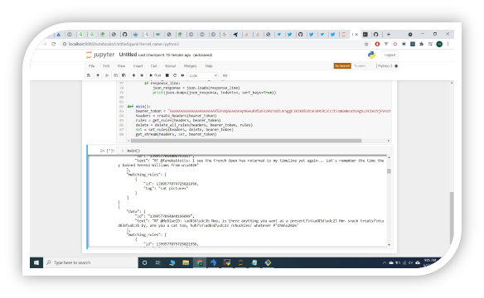

Data Sources
1) Tweet’s dataset 1.6 million tweets with tags(positive/negative)
https://www.kaggle.com/kazanova/sentiment140
2) Twitter Real Time Stream Api’s
https://developer.twitter.com/en/docs/tutorials/stream-tweets-in-real-time

Slide 5

Project Goal
To find the real time Twitter Data trends.
To mark tweets trend if it has gone on positive way or negative way i.e. favoring spike or bad spike

Slide 6
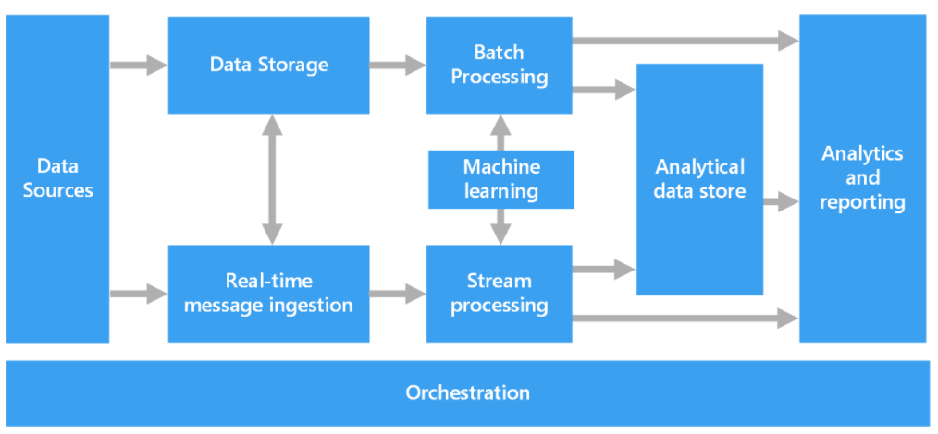
Lambda Architecture
Data-processing architecture designed to handle massive quantities of data by taking advantage of both batch and stream-processing methods.
Provides low latency, high throughput and fault tolerance.

Slide 7
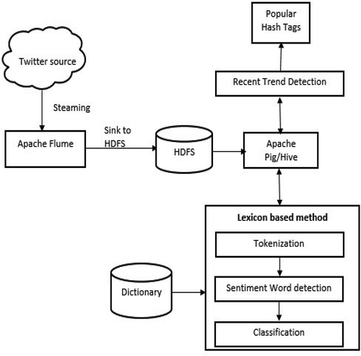
Hadoop Ecosystem Architecture
Hadoop Ecosystem is a platform or a suite which provides various services to solve the big data problems.

Slide 8
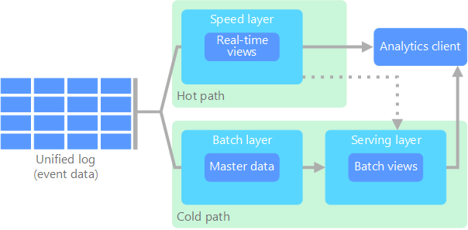
Azure Lambda Architecture
A batch layer stores all of the incoming data in its raw form and performs batch processing on the data
A speed layer analyzes data in real time. This layer is designed for low latency, at the expense of accuracy.
The batch layer feeds into a serving layer that indexes the batch view for efficient querying.

Slide 10


